Slide 1
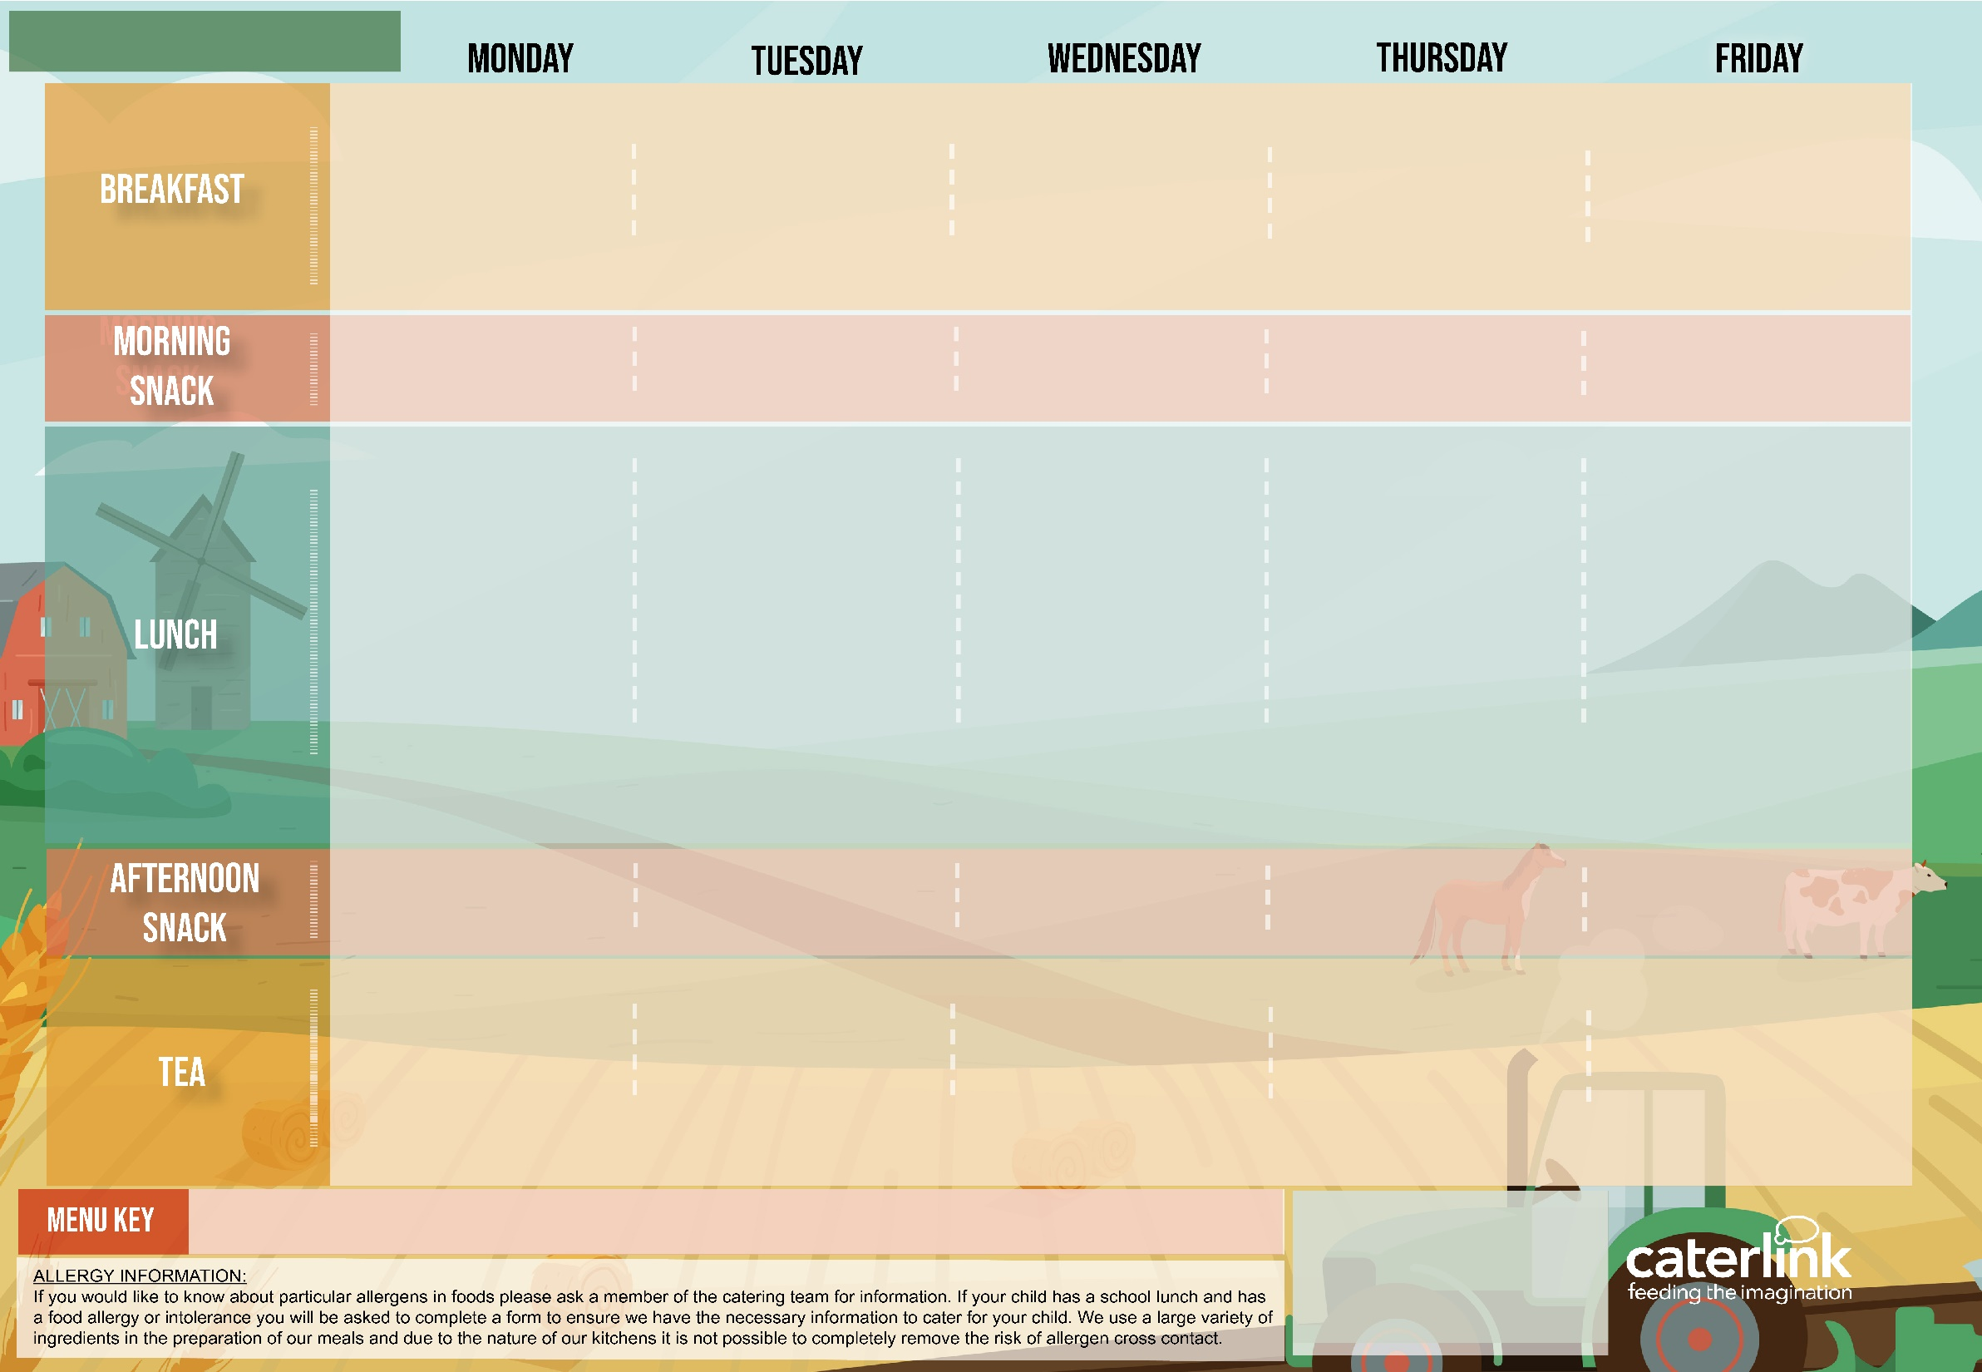



ISLINGTON EARLY YEARS MENU WEEK ONE
Weetabix with Milk (V) or Soya Milk (VE) Boiled Egg (V), Wholemeal Soldiers (VE) & Roasted Tomatoes (VE) | Peach & Berry Porridge made with Milk (V) or Soya Milk (VE) Pancake (V) Apple Wedges (VE) | Weetabix with Milk (V) or Soya Milk (VE) Red Pepper Frittata (V) Toasted English Muffin (V) and Mushrooms (VE) | Peach, Berry & Porridge made with Milk (V) or Soya Milk (VE) Crumpets (V) with Spread (VE) Banana Fingers (VE) | Banana Porridge made with Milk (V) or Soya Milk (VE) Wholemeal Bagel (V) Berries & Watermelon (VE)
English Muffin (V) with Spread (VE) | Melon Fingers (VE) | Pitta Sticks (V) and Cucumber Sticks (VE) | Banana Fingers (VE) | Wholemeal Bread Fingers (VE) with Houmous (VE)
Classic Soya Mince Spaghetti Bolognaise (VE) with Wholemeal Pasta (VE) |  | Mildly Spiced Mixed Bean Jollof Rice (VE) | Butternut Squash & Lentil Lasagne (V) | Vegetable Sticks (VE) with Natural Yoghurt (V)
 | Wholemeal Tomato and Lentil pasta
 |  |  |  | Red Pepper & Cheese Frittata (V) with Mashed Potato and Gravy (VE)
Hearty Beef & Lentil Bolognaise with Wholemeal Pasta |  | Chicken Jollof Rice | Beef & Lentil Lasagne
Broccoli (VE) Sweetcorn (VE) & Mixed Leaf Salad (VE) | Spring Greens (VE), Cauliflower (VE) & Carrot Sticks (VE) | Green Beans (VE), Red Cabbage (VE) & Grated Carrot & Raisin Salad (VE) | Carrot & Courgette Medley (VE) & Potato & Chive Salad (VE) | Roast Chicken with Gravy and Mash
 | Natural Yoghurt (V) & Banana Fingers (VE)
Natural Yoghurt (V) with Tinned Pears(VE) |  | Natural Yoghurt (V) & Fresh Fruit Salad (VE) | Pear Cobbler (VE) with Custard (V) | Steamed Peas (VE), Baked Beans (VE) & Sweetcorn Salsa (VE)
A selection of seasonal fresh fruits served daily including apple, pear, banana, oranges & melon (VE)
Crudités (VE) with Yoghurt and Cucumber Dip (V) | Pitta Sticks (VE) and Houmous (VE) | Apple Slices (VE) | English Muffin (V) With Soft Cheese (V) | Pepper and Carrot Crudités (VE)
Houmous (VE) & Crudites (VE) ~ Cheese on Toast (V) with Carrot and Beetroot Slaw (VE) | Pear (VE) & Cheese Slices (V) ~ Caribbean Squash & Butterbean Curry (VE) | Wholemeal Tuna Pasta Bake or Wholemeal Lentil Pasta Bake (VE) With Broccoli (VE) ~ Natural Yoghurt (V) with Orange Wedges | Baked Beans (VE) on 50% Wholemeal Toast (VE) with Mushrooms (VE) ~ Melon (VE) & Natural Yoghurt (V) | Afternoon Tea Picnic Toast Fingers with: egg mayonnaise (V), cream cheese and cucumber (V) or butter bean dip and salsa (VE) ~ Fruit & Veg: Pineapple (VE) & Tomato Quarters (VE)
Added Plant Protein
Low Carbon Planet
Friendly
Contains Flaxseed
(High in Omega-3)
(V) Vegetarian
(VE) Vegan
Available Daily:
Daily salad selection (V/VE)
Fresh Fruit (VE)
Natural Yoghurt (V)
Drinking Milk (V/VE)
Tap Water
Wholemeal

Slide 2
ISLINGTON EARLY YEARS MENU WEEK TWO
Peach and Berry Porridge made with Milk (V) or Soya Milk (VE) Wholemeal Toast (VE) Fresh Orange Wedges (VE) | Weetabix with Milk (V) or Soya Milk (VE) Boiled Egg (V), English Muffin (V) and Roasted Tomatoes (VE) | Apple and Cinnamon Porridge made with Milk (V) or Soya Milk (VE) Crumpets (V) with Spread (VE) Banana Fingers (VE) | Berry & Flaxseed Porridge made with Milk (V) or Soya Milk (VE) Toasted Wholemeal Bagel (V) Fresh Pear Slices (VE) | Weetabix with Milk (V) or Soya Milk (VE) Homemade Five Beans in Tomato Sauce (VE) Toasted English Muffin (V) & Mushrooms (VE)
Pitta Sticks (VE) with Spread (VE) | Seasonal Pear Quarters (VE) | Wholemeal Bread Fingers (V) with Houmous (VE) | Carrot and Cucumber Sticks (VE) | English Muffin (V) with Yoghurt & Cucumber Dip (V)
Five Bean Chilli (VE) Loaded Jacket Potato (VE) | Melon Boats (VE) & Cheese Slices (V) | Parsnip & Sweet Potato Loaf (V) with Skin on Roast Potatoes or New Potatoes (VE) & Gravy (VE) | Creamy Butterbean Macaroni Cheese (V) with Garlic & Herb Bread (VE) | BBQ Quorn Pieces (V) with Herby Potatoes (VE)
 | Chef’s Special aubergine & potato curry (VE) With Rice (VE)
 | Chicken Tikka Masala with Rice | Roast Chicken, Skin on Roast Potatoes or New Potatoes & Gravy | Creamy Salmon and Spinach Pasta Bake with Garlic & Herb Bread | Chicken & Bean Stew with Herby Potatoes
Steamed Carrots & Peas (VE) & Pepper Sticks (VE) | Green Beans (VE), Sweetcorn (VE) & Cherry Tomato Quarters (VE) | Roasted Cabbage (VE), Cauliflower (VE) & Rainbow Slaw (VE) | Broccoli (VE) Cauliflower (VE) & Beetroot Salad (VE) | Baked Beans (VE), Peas (VE) & Cucumber Salad (VE)
Natural Yoghurt (V) Fruits of the Forest (VE) |  | Apple & Blackberry Crumble (VE) with Ice Cream (V) | Bananas (VE) & Custard (V) | Natural Yoghurt (V) & Fresh Fruit Salad (VE)
A selection of seasonal fresh fruits served daily including apple, pear, banana, oranges & melon (VE)
Crudités (VE) with Yoghurt and Cucumber Dip (V) | Wholemeal Bread Fingers (VE) with Spread (VE) | Apple Slices (VE) | Pitta Sticks (V) with Soft Cheese (V) | Banana Fingers (VE)
Herby Chicken and Bean Wrap with Courgettes (VE) or Beany Salsa Wrap (VE) with Courgettes (VE) ~ Orange Slices (VE) | Wholemeal Cheese and Tomato Pizza (V) with Sweet Potato Salad (VE) ~ Seasonal Apples Wedges (VE) | Crudites (VE) with Butterbean Dip (VE) ~ Pea, Spinach and Tomato Frittatas (V) with Herby Couscous (VE) and Sweetcorn(VE) | Tomato, Lentil & Basil Pasta (VE) with Carrot Sticks (VE) Berries (VE) with Natural Yoghurt (V) | Afternoon Tea Picnic Toast Fingers with: egg mayonnaise (V), cheese and tomato (V) or hummus & carrot (VE) ~ Fruit & Veg: Melon (VE) & Carrot Sticks (VE)
Added Plant Protein
Low Carbon Planet
Friendly
Wholemeal
Contains Flaxseed
(High in Omega-3)
(V) Vegetarian
(VE) Vegan
Available Daily:
Daily salad selection (V/VE)
Fresh Fruit (VE)
Natural Yoghurt (V)
Drinking Milk (V/VE)
Tap Water

Slide 3
ISLINGTON EARLY YEARS MENU WEEK THREE
Banana & Flaxseed Porridge made with Milk (V) or Soya Milk (VE) Wholemeal Toast (V) Apple Wedges (VE) | Weetabix (VE) with Milk (V) or Soya Milk (VE) Boiled Egg (V), Wholemeal Bagel (V) and Roasted Tomatoes (VE) | Apple and Cinnamon Porridge made with Milk (V) or Soya Milk (VE) English Muffin (V) with Spread (VE) Orange Wedges (VE) | Weetabix (VE) with Milk (V) or Soya Milk (VE) Scrambled Eggs with Homemade Baked Beans (V), Tortilla Wrap and Mushrooms (VE) | Berry & Flaxseed Porridge made with Milk (V) or Soya Milk (VE) Pancake (V) Banana Slices (VE)
Pitta Sticks (V) with Houmous (VE) | Banana Fingers (VE) | English Muffin (VE) and Soft Cheese (V) | Apple Slices (VE) | Wholemeal Bread Fingers (V) with Butterbean Dip (VE)
Cheese & Tomato Pizza (V) | Beetroot & Lentil Burger (VE) with Sweet Potato Wedges (VE) | Vegetable Sticks (VE) with Yoghurt Mint Dip (V) | Chefs Special Moroccan Vegetable & Chickpea Couscous (VE) | Broccoli Swirls (V) with Mashed Potatoes (VE)
 |  | Soya Mince Cottage Pie(VE) with Gravy (VE)
BBQ Chicken Pizza | Beef Burger with Sweet Potato Wedges | Cottage Pie with Gravy |  | Roast Chicken with Mashed Potatoes (VE)
Sweetcorn (VE) Carrots (VE) & Fresh Broccoli Salad (VE) | Green Beans (VE) Roasted Peppers (VE) & Homemade Coleslaw (V) | Roasted Carrots (VE), Tomatoes (VE) Swede (VE) | Roasted Cauliflower (VE) Beetroot & Orange Salad (VE) & Mixed Leaf Salad (VE) | Steamed Peas (VE) Baked Beans (VE), Sweet Potato & Coriander Salad (VE)
Eves Pudding (V) with Custard (V) | Natural Yoghurt (V) with Blackberries (VE) |  | Apple & Blackberry Crumble with Custard (V) | Natural Yoghurt (V) and Fresh Fruit Salad (VE)
A selection of seasonal fresh fruits served daily including apple, pear, banana, oranges & melon (VE)
Crudités (VE) with Yoghurt and Cucumber Dip (V) | Wholemeal Bread Fingers (VE) with Spread (VE) | Seasonal Apple Quarters (VE) | English Muffin (V) with Yoghurt & Cucumber Dip (V) | Crudités – Carrot and Cucumber Sticks (VE)
Jacket Potato (VE) with Baked Beans (VE) or Tuna and Sweetcorn with Cucumber and Beetroot Salad (VE) ~ Apple Slices (VE) with Natural Yoghurt (V) | Wholemeal Tomato & Lentil Pasta (VE) with Peas (VE) ~ Orange Wedges (VE) & Natural Yoghurt (V) | Melon Boats (VE) ~ Red Pepper and Cheese Frittata (V) with Parsley Potatoes (VE) and Broccoli (VE) | Chicken & Bean or Vegetable & Bean Fajitas (VE) with 50% Wholemeal Rice (VE) ~ Natural Yoghurt (V) & Banana (VE) | Afternoon Tea Picnic Toast Fingers with: egg mayonnaise (V), cheese and tomato (V) or hummus & carrot (VE) ~ Fruit & Veg: Tinned Pears (VE) & Cucumber Sticks (VE)
Added Plant Protein
Low Carbon Planet
Friendly
Wholemeal
Contains Flaxseed
(High in Omega-3)
(V) Vegetarian
(VE) Vegan
Available Daily:
Daily salad selection (V/VE)
Fresh Fruit (VE)
Natural Yoghurt (V)
Drinking Milk (V/VE)
Tap Water

