Slide 1
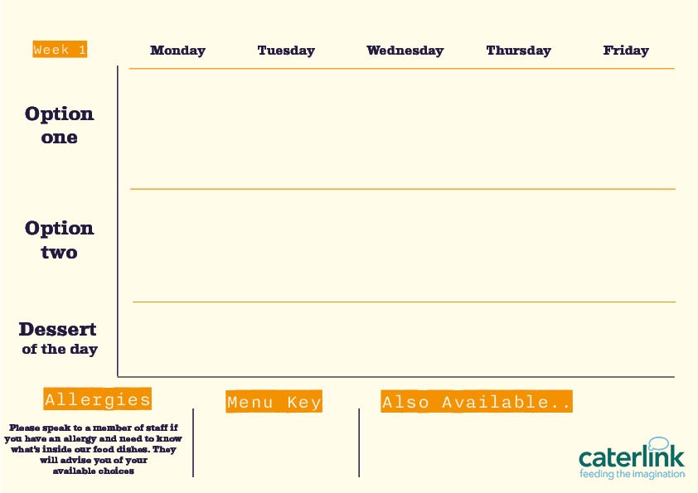







Secondary Menu 2026 -27
Butternut & Feta Quesadilla and Wedges
with
Fresh Salad
Quorn Roast with all the Trimmings
with Roast Potatoes, Seasonal Veg and Gravy
Sweet Potato, Chickpea & Spinach Tikka
with 50/50
Rice and Sambals
Delhi Hound Dog
with Mango Chutney, Served with Chips
Falafel Bowl
with Tabbouleh, Tomato Salad
Smokey Beef Chilli Tacos and Wedges
With
Fresh Salad
Roast Chicken with all the Trimmings
with Roast Potatoes, Carrots, Broccoli
and Gravy
Chicken Shawarma
with Tabbouleh, Tomato Salad
Chicken Tikka Masala
with 50/50 Rice and
Sambals
Fishfinger Sandwich
with Chips, Peas and Tartare Sauce
Sticky Toffee Apple Crumble
with Custard
Oaty cookie & Fresh Fruit
Pineapple Upside Down Cake
Yoghurt & Fresh Fruit
Warm Banana Flapjack
Vegan option
A choice of Meat, Vegetarian & Vegan Wraps, Baguettes, Bagels and Pittas alongside Soup of the Day and Filled Jacket Potatoes
Fresh Fruits & Yoghurt
Added plant protein
Source of wholemeal

Slide 2



Secondary Menu 2026 -27
Broccoli
and Feta Quiche
with Salad and Chips
Smokey Bean
Burger
with Spicy Rice and Rainbow
Slaw
Burrito Bowl
with Rice, Salad
and
Sour Cream
Vegetable Biryani
with Rice
Mac and Cheese with Toppings
Croutons, Pepperoni Pieces, Crispy Onions, Spring Onions, Barbecue Beans
Battered Fish or Salmon Fishcake
and Chips with Garden Peas
Original Spice Chicken
with Spicy Rice and Rainbow Slaw
BBQ Pulled Pork Slider
with Paprika Wedges and Slaw
Chicken
Biryani
with Rice
Orange & Lemon Shortbread
Cherry Apple Crumble
with Custard
Yoghurt & Fresh Fruit
Peach Upside Down Cake
with Custard
Cinnamon Apple Turnover
Vegan option
A choice of Meat, Vegetarian & Vegan Wraps, Baguettes, Bagels and Pittas alongside Soup of the Day and Filled Jacket Potatoes
Fresh Fruits & Yoghurt
Added plant protein
Source of wholemeal

Slide 3



Secondary Menu 2026-27
Yakisoba Soya
Noodles
Stir Fry with Vegetables
Tuscan Chickpea Pasta
with Garlic Bread
and Chunky Roasted Veg
Chip Shop Vegan Sausage
with Chips, Mushy Peas and Gravy or Curry Sauce
Spanakopita
With Seasoned Potatoes, Tzatziki and Greek Salad
Curried Squash & Butterbeans
With Rice
Gochujang Sticky Chicken
with Rice and
Salad
Classic Beef Lasagne
with Garlic Bread and Chunky Roasted Veg
Chip Shop Fish or Sausage
with Chips, Mushy Peas and Gravy or Curry
Sauce
Chicken Souvlaki
with Seasoned Potatoes, Tzatziki
and Greek Salad
Jerk Chicken Thighs
with Rice & Peas
Plum Crumble
with Custard
Yoghurt & Fresh Fruit
Chocolate Orange Cookie
Apple Pie
with Custard
Blueberry & Lemon Flapjack
Vegan option
A choice of Meat, Vegetarian & Vegan Wraps, Baguettes, Bagels and Pittas alongside Soup of the Day and Filled Jacket Potatoes
Fresh Fruits & Yoghurt
Added plant protein
Source of wholemeal

