Slide 1
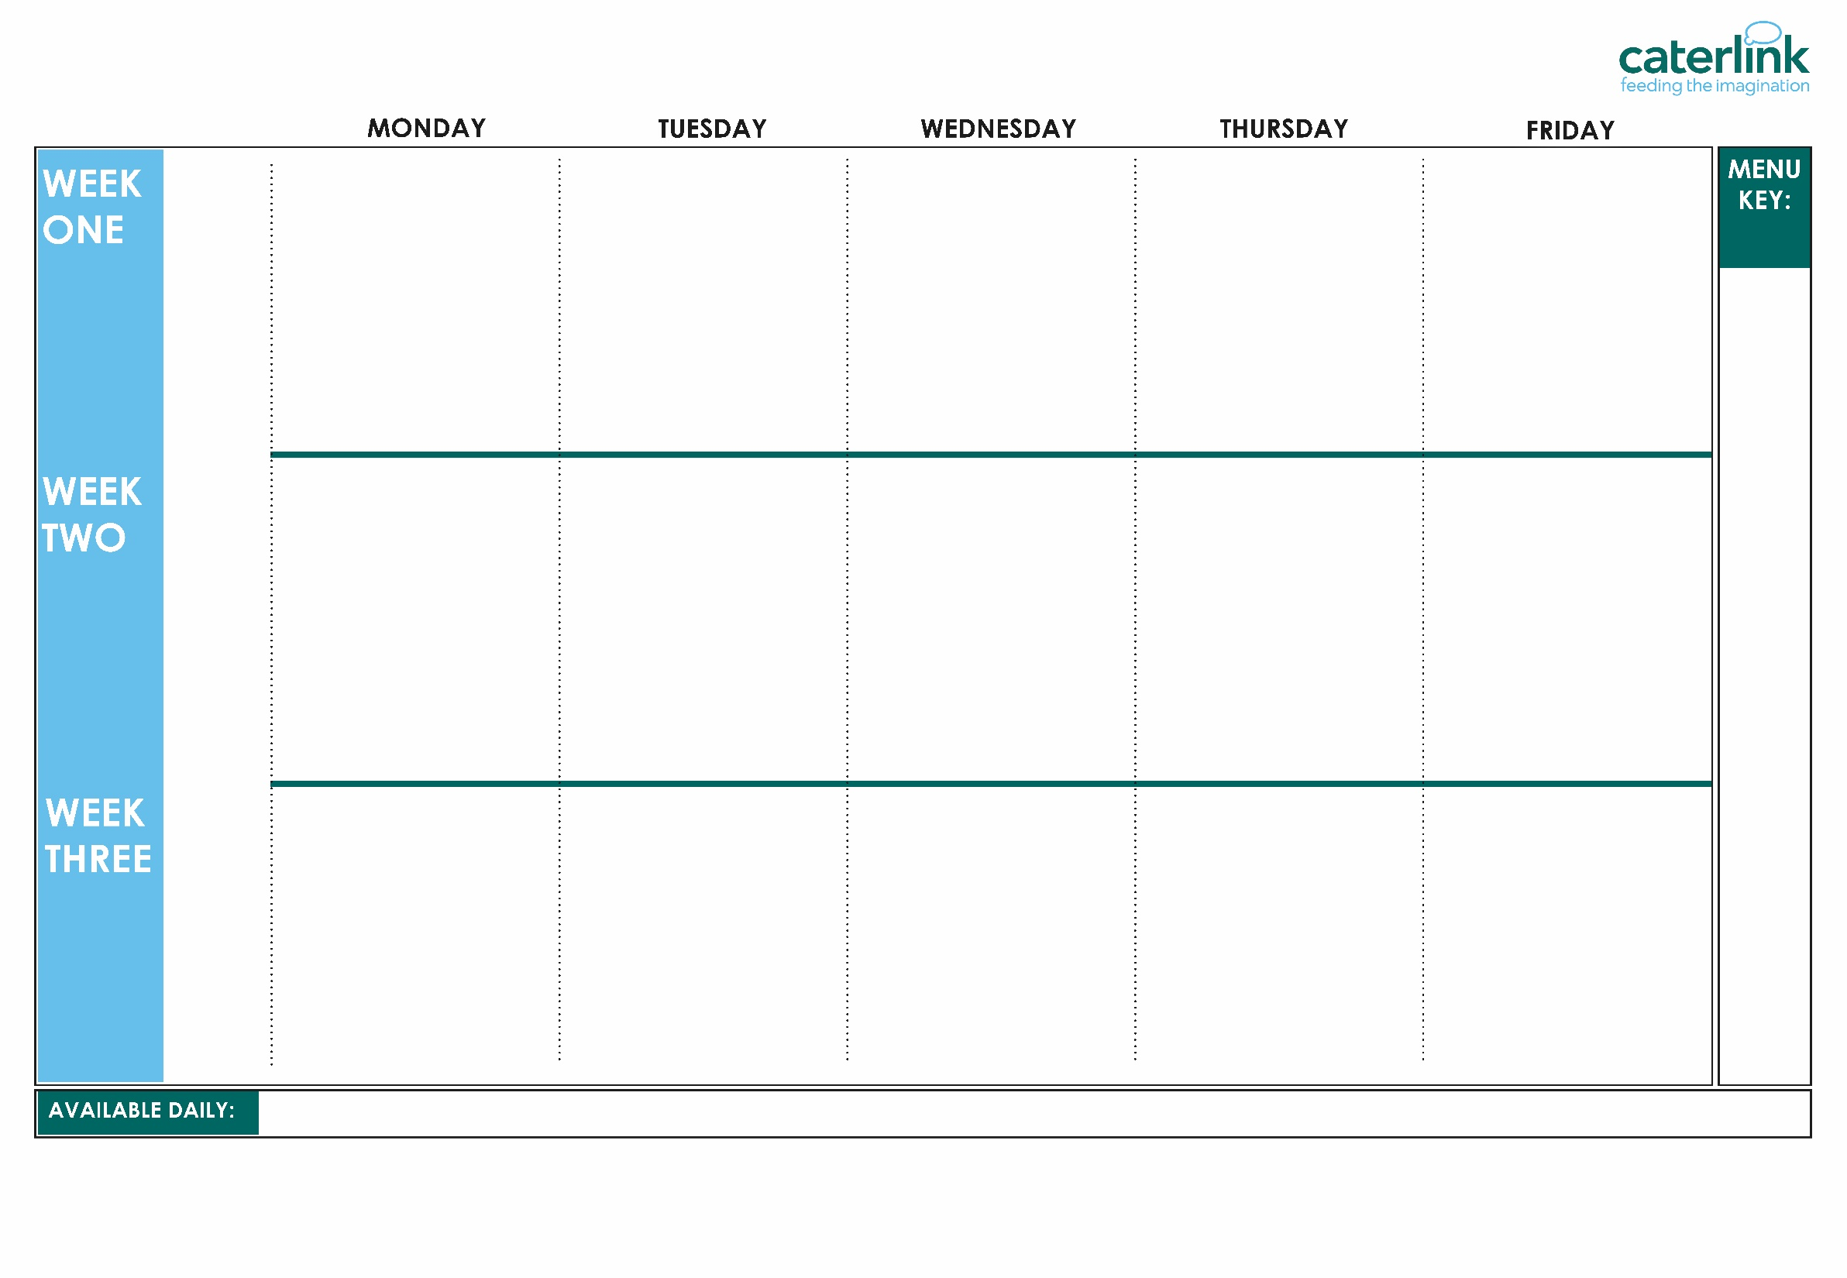
ISLINGTON AUTUMN WINTER MENU 2026 / 2027
Option
One
Option
Two
Sides
Dessert
Macaroni Cheese (V) | Vegetable Tagine with Rice (VE) | Lentil Wellington with Roast Potatoes and Gravy (VE) | Saucy Tomato and Bean Pasta Bake (VE) | Red Pepper Frittata with Chips & Homemade Tomato Sauce (V)
Autumn Harvest Lasagne (V) | Hearty Beef and Lentil Bolognaise with Spaghetti | Roast Chicken, Stuffing, Roast Potatoes and Gravy | Chicken Tikka Masala with Rice and Turmeric Bread | Battered Fish with Chips & Homemade Tomato Sauce
Broccoli (VE) Carrots (VE) | Green Beans (VE) Cauliflower (VE) | Sweetcorn (VE) Green Cabbage (VE) | Butternut Squash (VE) Cauliflower (VE) | Peas (VE) Bake Beans (VE)
Apple and Raisin Flapjack (VE) | Apple Crumb Cake with Custard (V) | Yoghurt (V) Fresh Fruit – Platter (VE) | Strawberry Jelly with Mandarins (VE) | Yoghurt (V) Fresh Fruit – Salad (VE)
Whole
grain
Tuna Pasta Bake | Lentil and Basil Whirl (VE) with Wedges(VE) | Lentil and Roasted Vegetable Pasta (VE) | Creamy Chickpea and Coconut Curry with Rice (VE) | Tomato Butterbean Pasta (VE)
Classic Cheese and Tomato Pizza with Wedges (V) | Chicken & Sweetcorn Meatballs in Tomato Sauce with Rice | BBQ Chicken with Seasoned Potatoes & Sweetcorn Salsa | Beef Lasagne with Garlic Bread | Breaded Fish or Fishfingers with Chips & Homemade Tomato Sauce
Green Beans (VE) Cauliflower (VE) | Carrots (VE) Sweetcorn (VE) | Broccoli (VE) Peas (VE) | Carrots (VE) Courgettes (VE) | Peas (VE) Baked Beans (VE)
Peach Upside Down Cake (V)with Custard (V) | Chocolate and Banana Oaty Square (VE) | Yoghurt (V) Fresh Fruit – Platter (VE) | Sticky Toffee Apple Crumble (VE) with Custard (V) | Yoghurt (V) Fresh Fruit – Salad (VE)
Option
One
Option
Two
Sides
Dessert
Plant
based
Added plant protein
Option
One
Option
Two
Sides
Dessert
Mild Mexican Chilli with Rice (VE) | Hearty Spaghetti Bolognaise (VE) | Planet Friendly Sausage and Roast Potatoes and Gravy (VE) | Caribbean Stew with Golden Rice (VE) | Cheese and Bean Pasty with Chips (V)
Macaroni Cheese (V) | Chicken Enchilada Bake with Paprika Wedges | Mild Caribbean Chicken with Roast Potatoes | Minced Beef Cottage Pie | Fishfingers with Chips & Homemade Tomato Sauce
Sweetcorn (VE) Peas (VE) | Carrots (VE) Broccoli (VE) | Green Beans (VE) Cauliflower (VE) | Carrots (VE) Butternut Squash (VE) | Baked Beans (VE) Peas(VE)
Yoghurt (V) with Fresh Fruit – Platter (VE) | Pear Crumble with Custard (V) | Yoghurt (V) and Fresh Fruit -Platter(VE) | Wholemeal Orange and Cinnamon Shortbread (VE) | Chocolate and Apple Sponge and Chocolate Sauce (V)
(VE)
Vegan
(V)
Veggie
Jacket Potatoes with a choice of fillings (V/ VE), Salad Bar (V/ VE), Freshly Baked Bread (V/VE), Fresh Fruit (VE), Yoghurt (V)
If you would like to know about particular allergens in foods, please ask a member of the catering team for information. If your child has a school lunch and has a food allergy or intolerance you will be asked to complete a form to ensure we have the necessary information to cater for your child. We use a large variety of ingredients in the preparation of our meals and due to the nature of our kitchens it is not possible to completely remove the risk of allergen cross contact.

